Slide 1


ECE 425 MP2 Presentation
Jack Arndt
April 27TH, 2022
DEPARTMENT OF ELECTRICAL & COMPUTER ENGINEERING
GRAINGER ENGINEERING

Slide 2

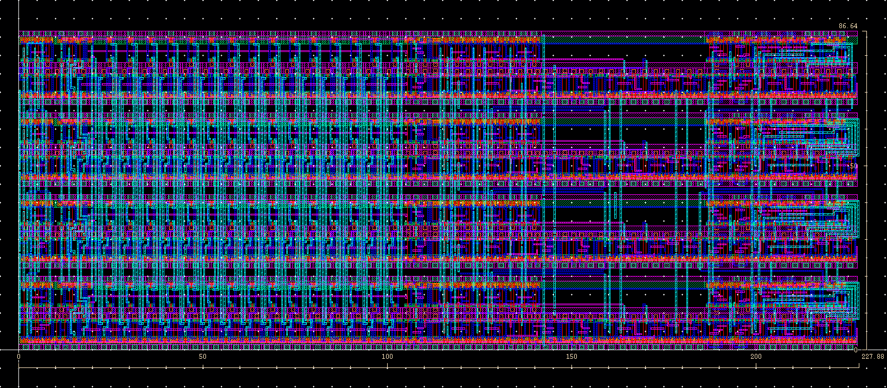
Overall Layout
Cell Height
Cell Width
Area of datapath Layout = 227.88 [µm] * 86.64 [µm] = 19,743.5232 [µm²]
ECE 425 MP2 PRESENTATION
GRAINGER ENGINEERING

Slide 3
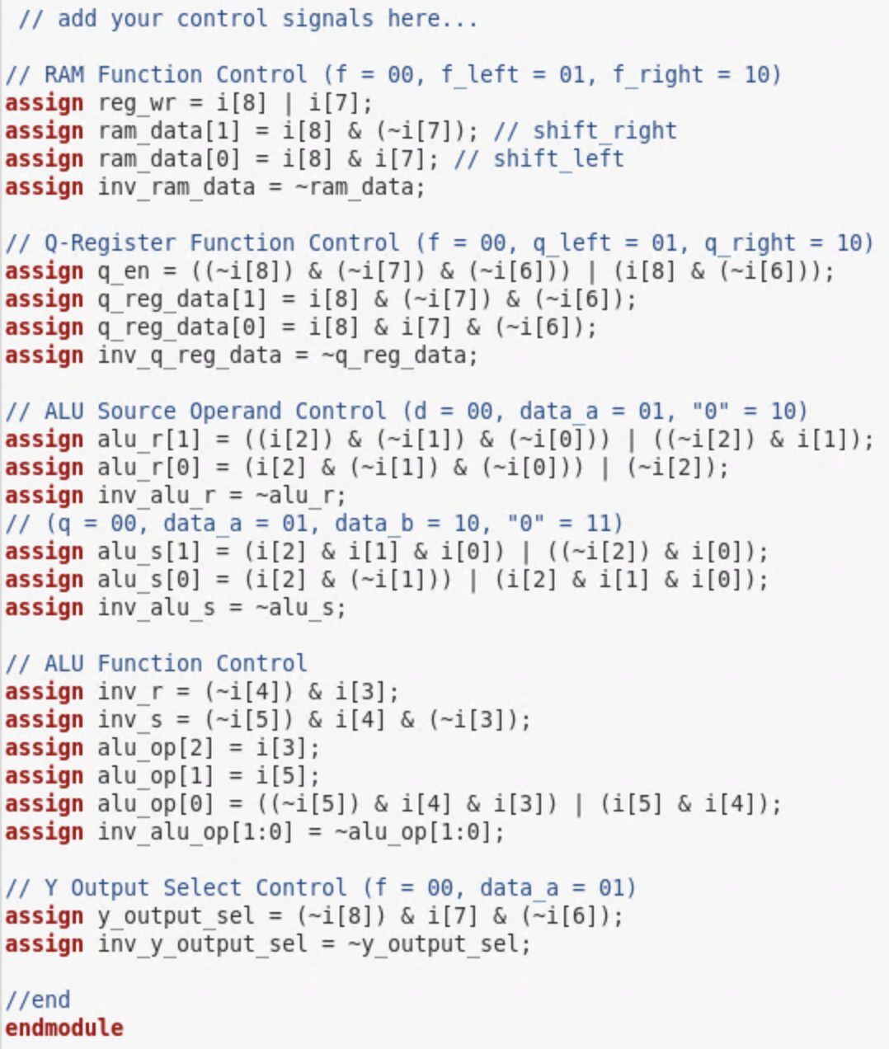
Control Signals
Control Signals are defined using minimum SOP (i.e. Sum-of-Products) form
Boolean logic expressions derived using AM2091 literature and documentation
Tradeoff Consideration: datapath will be most efficient if kept small (i.e. using the minimum number of transistors). Therefore, it recommended to keep functionality out of datapath and inside the control unit by creating complementary control signals in place of logic gates, wherever possible
Ex. Using an inverter to generate an inverted signal
Code snippet from controller.v Verilog file
ECE 425 MP2 PRESENTATION
GRAINGER ENGINEERING

Slide 4
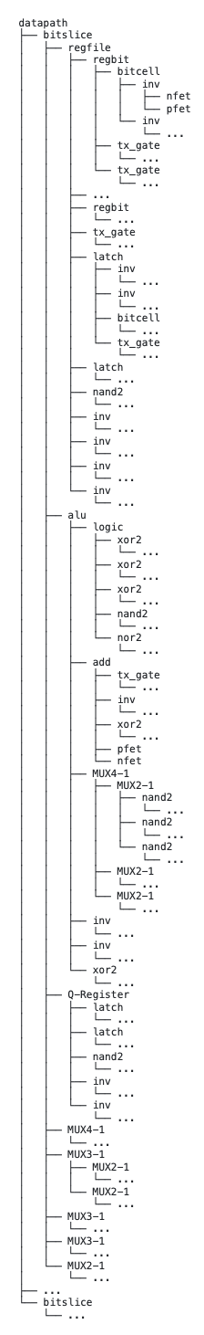
Hierarchical Structure of Overall Design
Design follows Hierarchical Structure (i.e. each cell is composed of other cells)
For example, datapath consists of four (4) bitslice cells, which can be further broken down into smaller (and simpler) “sub-cells,” according to the hierarchical structure shown to the left
Design Flow: Standard cells (i.e. inv, nand2, nor2, xor2, etc.) are used (and reused) to create larger components such as MUX2-1, which in turn are used to create even larger structures in the overall system design
ECE 425 MP2 PRESENTATION
GRAINGER ENGINEERING

Slide 5
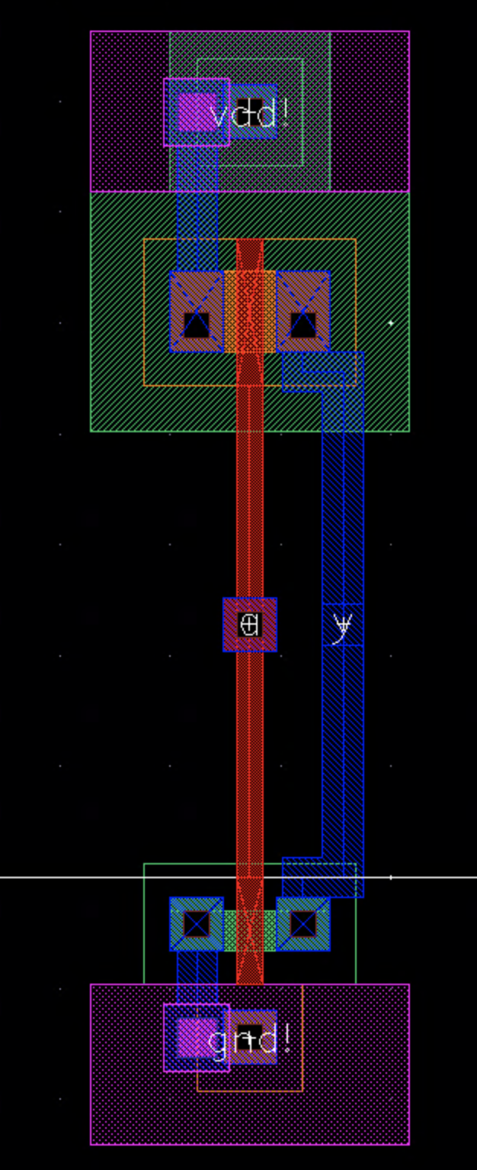
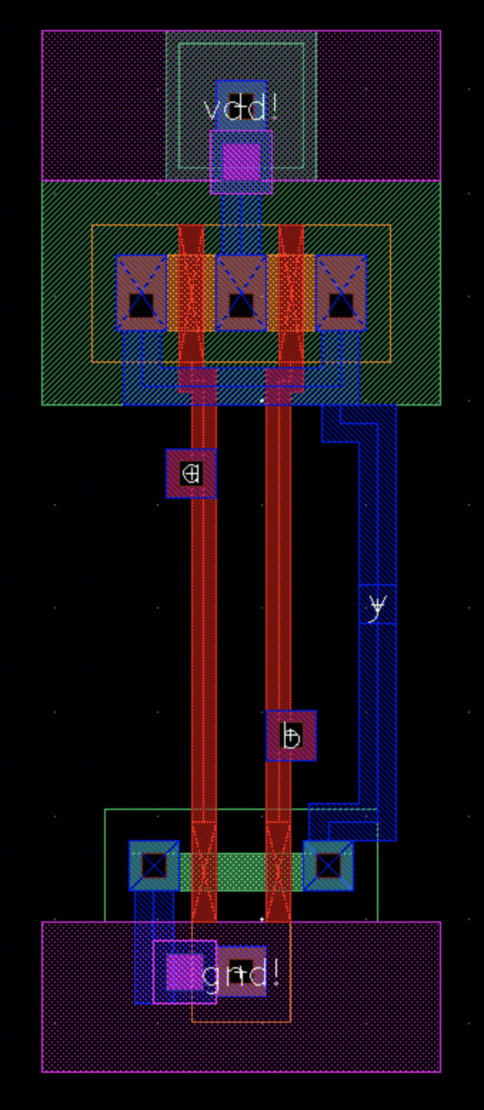
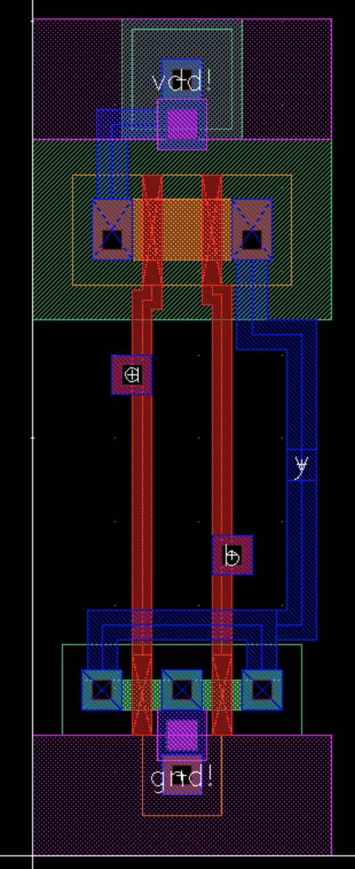
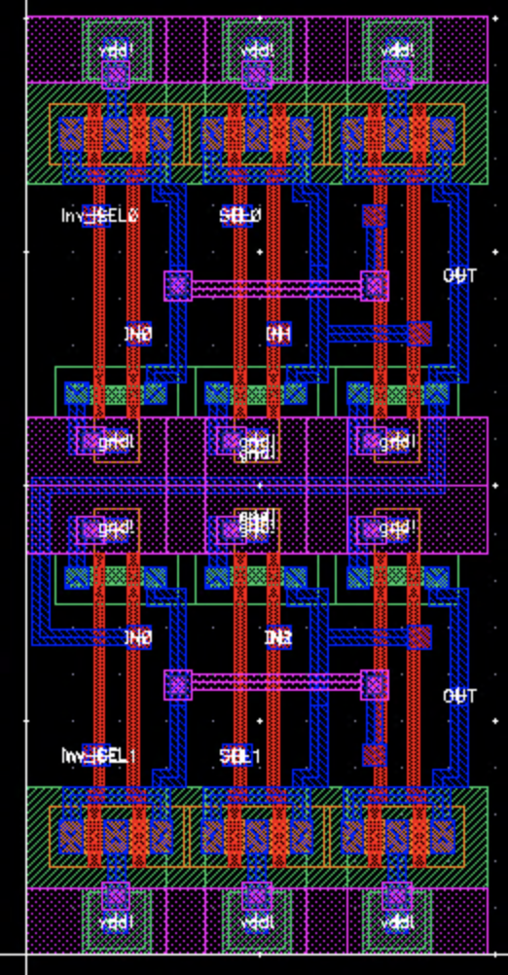
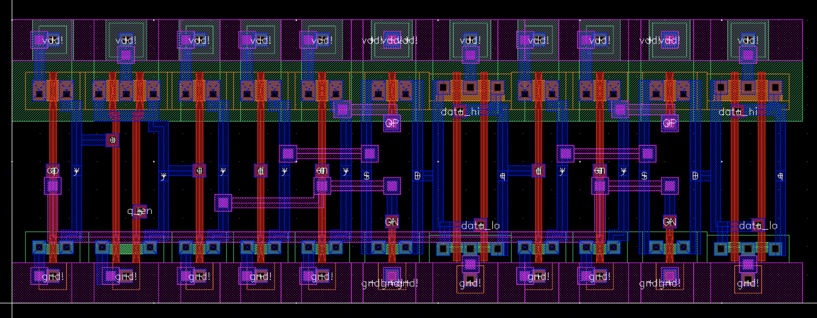
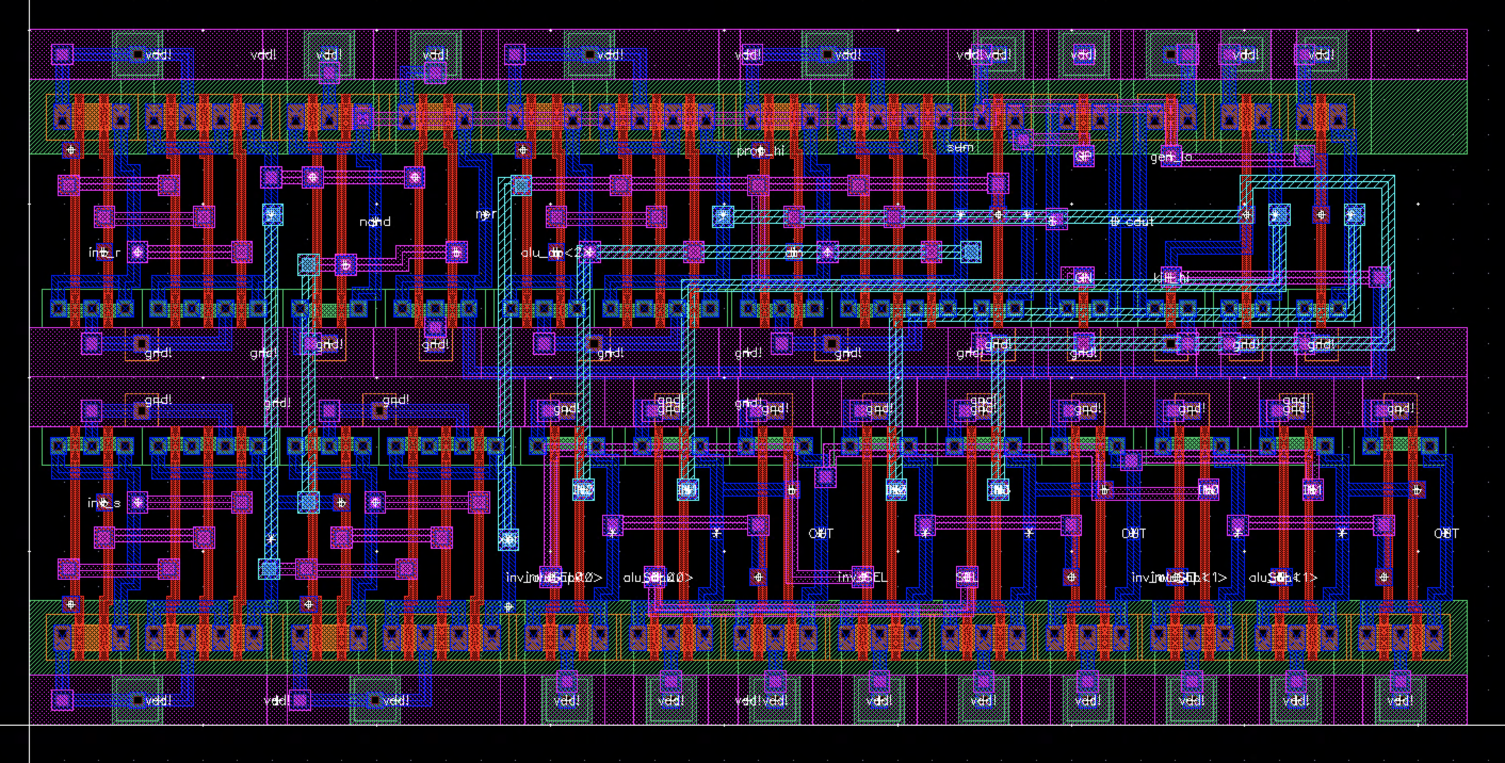
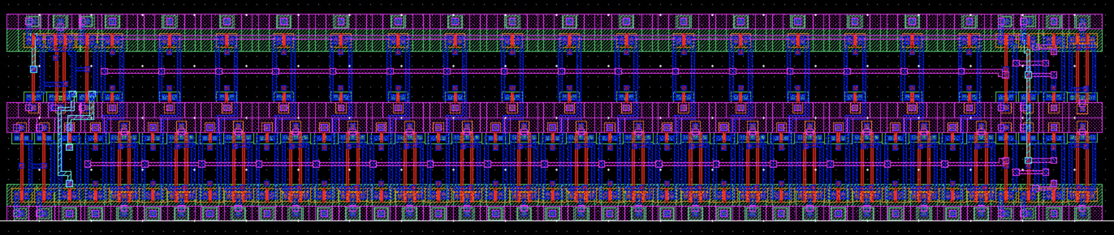
General Guidelines and Optimization Considerations
Cell Standardization: To preserve the modularity of the design, we took the approach of making the “rail-to-rail” distance approximately ~10 [µm] (i.e. cell height) across all cells. This value was chosen arbitrarily—with justification. We found that 10 [µm] was an adequate cell height such that each of the cell instances can more easily be connected (i.e. sharing/connecting power and ground rails) and maintain a “rectangular” cell shape, while leaving ample space between the n- and p- wells (in the vertical direction) for routing considerations. Note that in our layouts for the MUX3-1, alu, and regfile cells, we implemented a “double row” design, in which cell instances are “stacked” and share a common ground rail. This deliberate choice was made for these cells specifically to alleviate routing difficulties; however, while still maintaining a standardized cell shape and size.
~10 [µm]
inv Layout
nand2 Layout
nor2 Layout
~20 [µm]
~10 [µm]
~20 [µm]
Q-Register Layout
MUX3-1 ”Vertical” Layout
alu Layout
regfile Layout
ECE 425 MP2 PRESENTATION
GRAINGER ENGINEERING

Slide 6
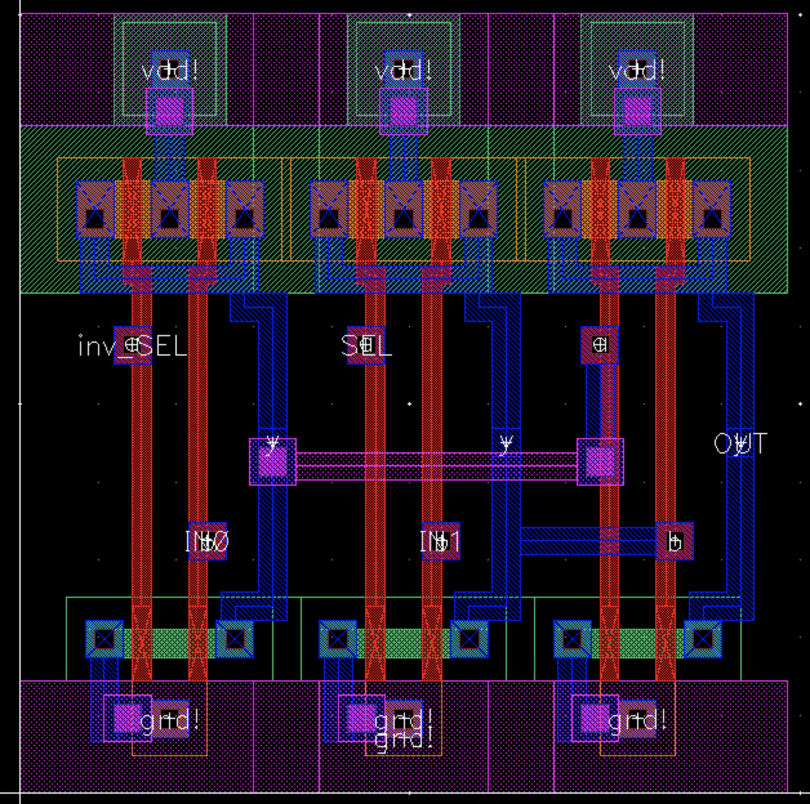
General Guidelines and Optimization Considerations cont.
Area Constraints: Given that the upper limit area constraint of this design is 20K [µm²], we strictly placed each instance in each cell as “near as possible” to each other in the horizontal direction, without violating DRC (e.g. metal1 min. distance of 0.36 [µm])
This is demonstrated to the right by the overlapping of the p- and n- diffusions
This later proved to recover a large amount of area that would have otherwise been used as the result of poor layout
MUX2-1 Layout
ECE 425 MP2 PRESENTATION
GRAINGER ENGINEERING

Slide 7
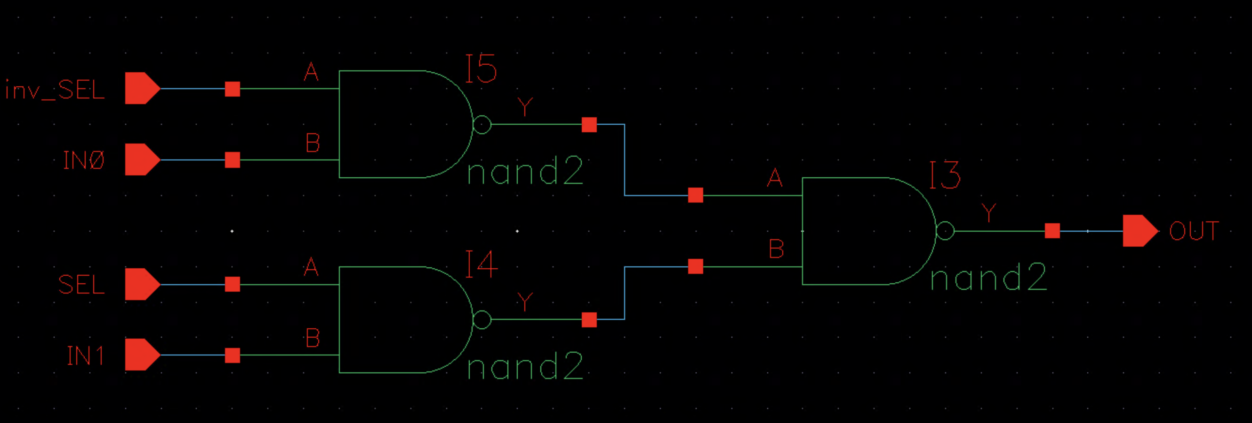
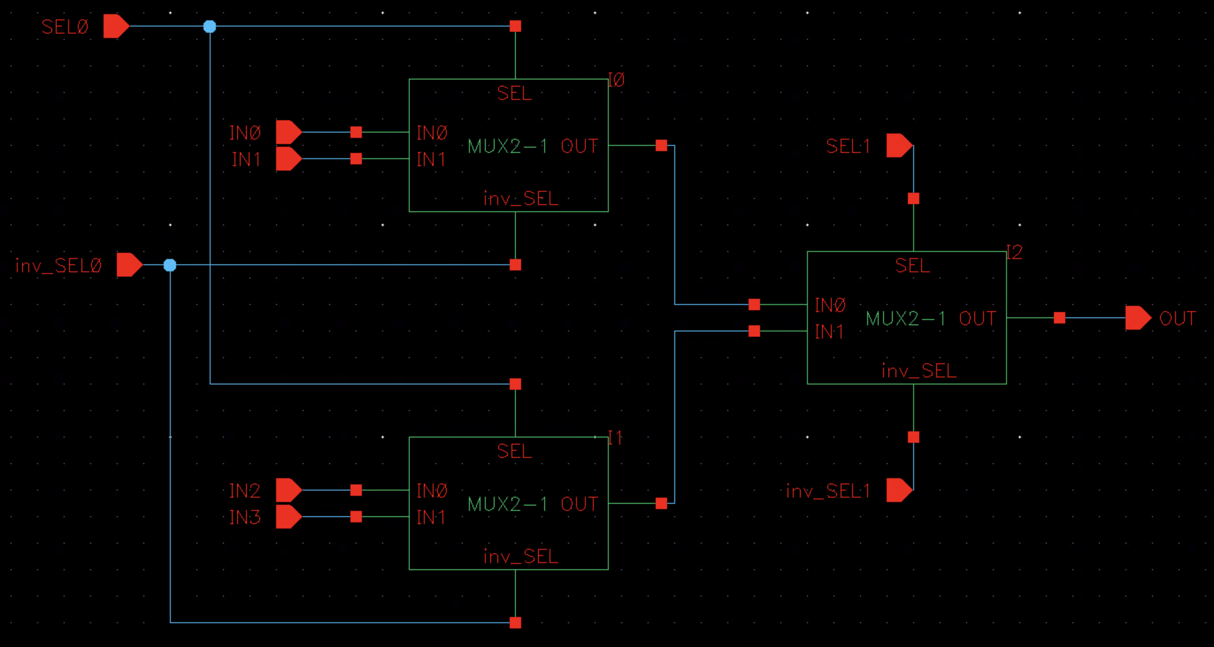
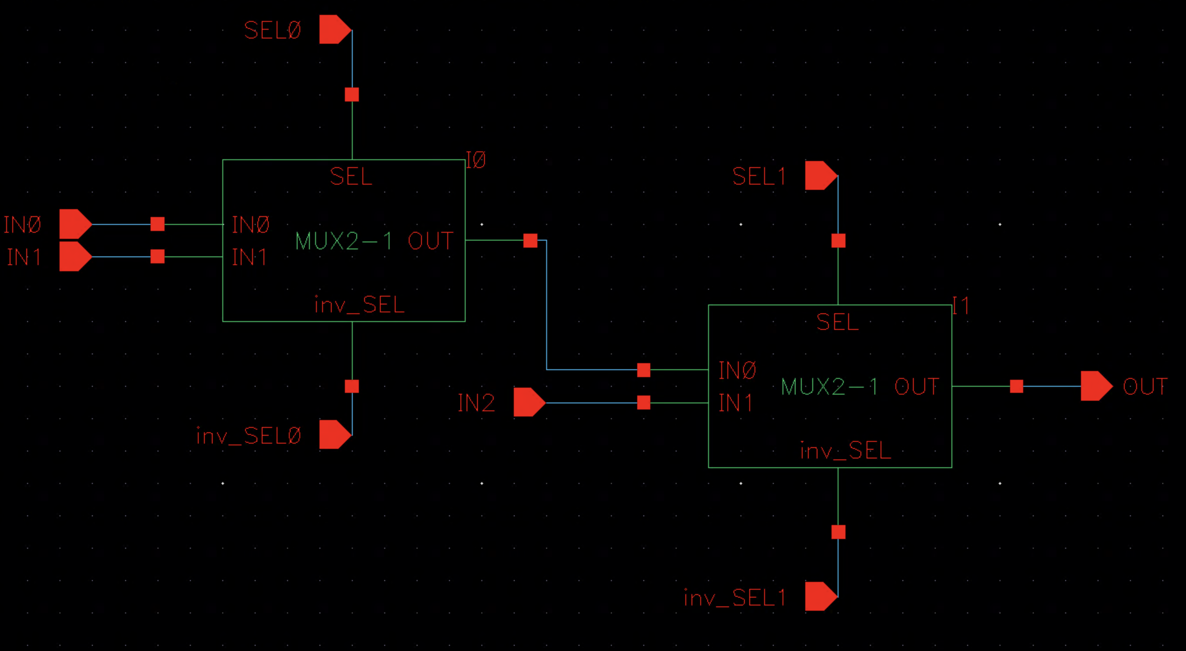
MUX Design
MUX2-1 Schematic
MUX4-1 Schematic
Advantages to NAND-based MUX design:
Only 12 transistors used in MUX2-1 design
“Full-Swing” (i.e. full logic “0” or “1”), non-inverting output
Modular layout of NAND cell simplified extension of MUX2-1 when creating larger structures such as MUX3-1 and MUX4-1
MUX3-1 Schematic
ECE 425 MP2 PRESENTATION
GRAINGER ENGINEERING

Slide 8
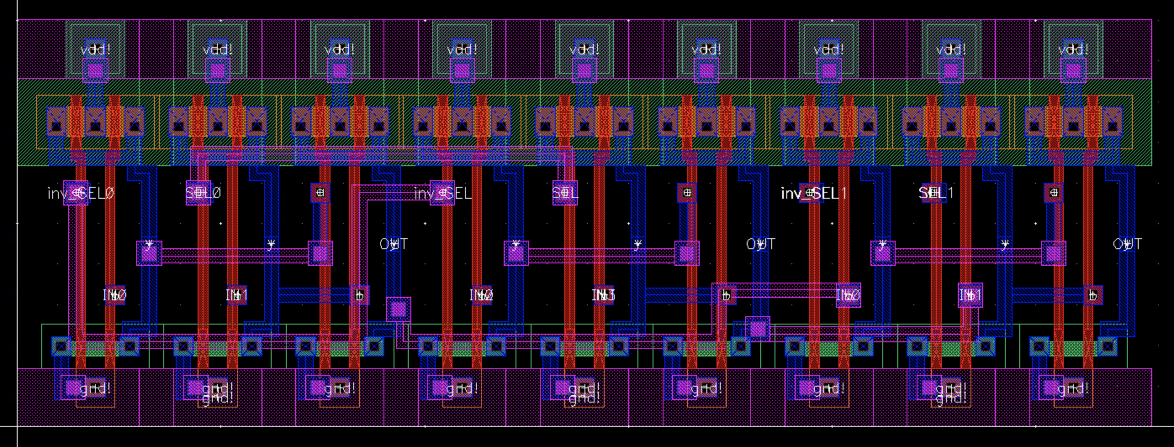
MUX Design cont.
MUX input and select signal contacts are ”staggered,” which later proved to be a favorable choice when routing signals between each bitslice
During nand2 cell layout, each poly-to-metal1 via was precisely placed such that a metal1-to-metal3 can be placed on top without causing additional DRC errors due to other nearby metal tracks
MUX2-1 Layout
datapath MUX signal routing
MUX4-1 Layout
ECE 425 MP2 PRESENTATION
GRAINGER ENGINEERING

Slide 9
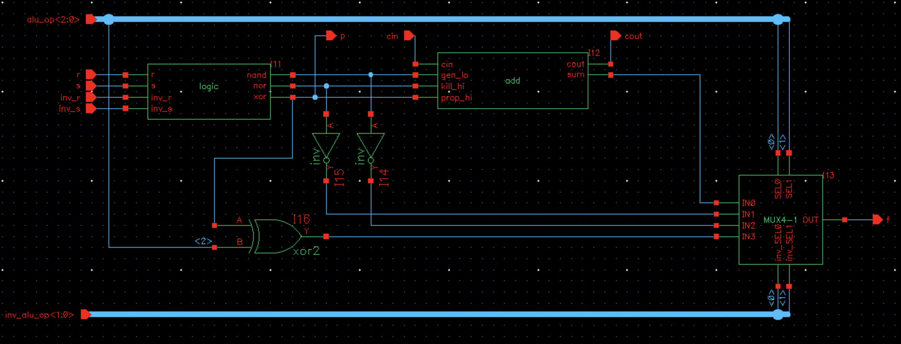
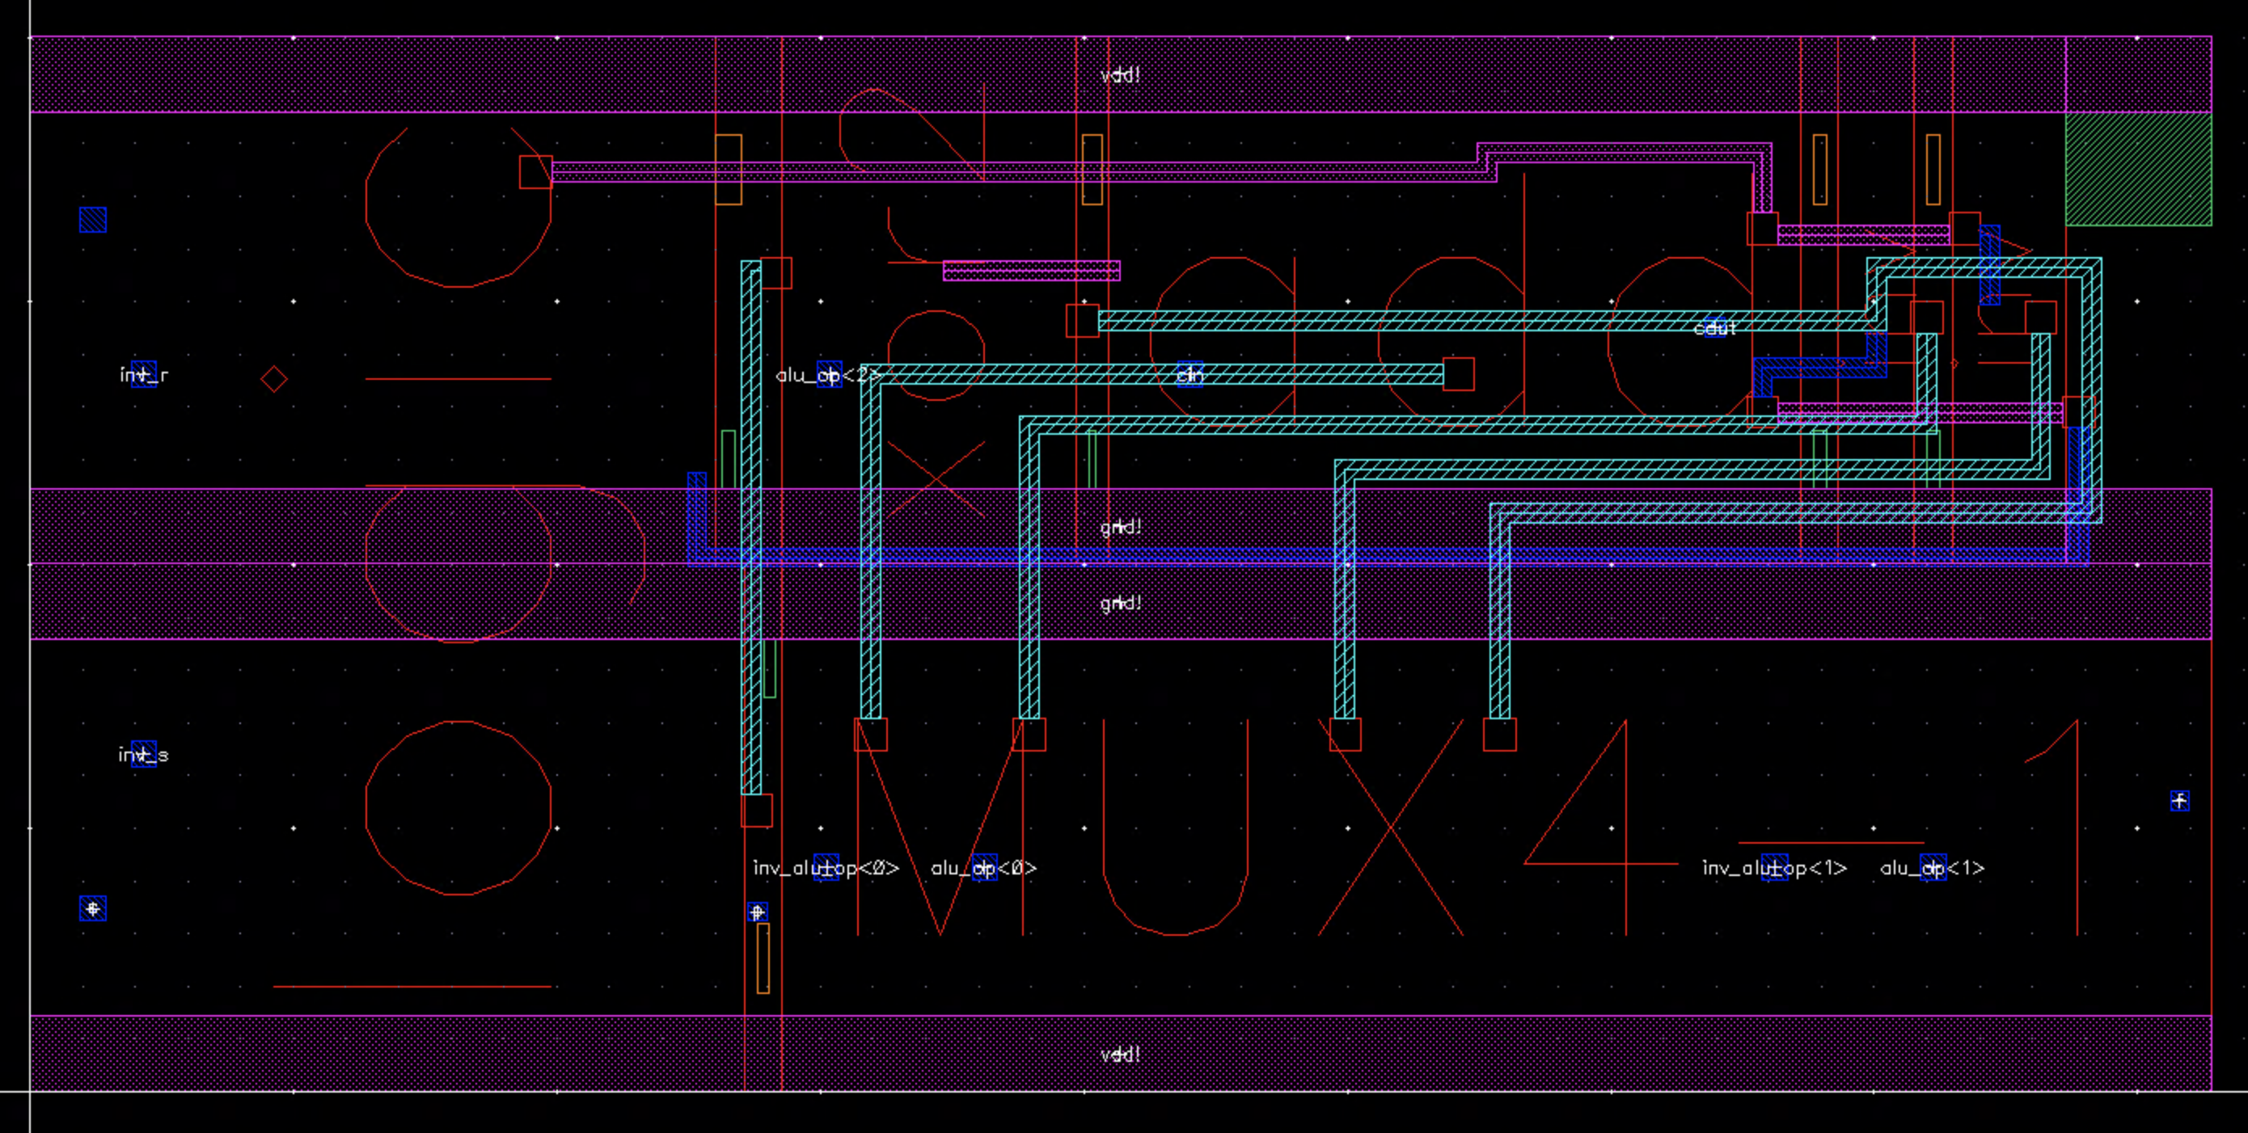
alu Design
Encoding of ALU function control signals allowed all eight operations of the ALU (i.e. ADD, SUBS, SUBR, OR, AND, NOTRS, EXOR, XNOR) to be collapsed into 4 inputs of a MUX4-1
Control signals alu_op<1:0> and inv_alu_op<1:0> are used as the select signals for the MUX
alu_op<2> used to select between EXOR and XNOR operation
First time metal3 is used in design
alu Schematic
alu Layout
alu Layout (Level 0 Hierarchy)
ECE 425 MP2 PRESENTATION
GRAINGER ENGINEERING

Slide 10
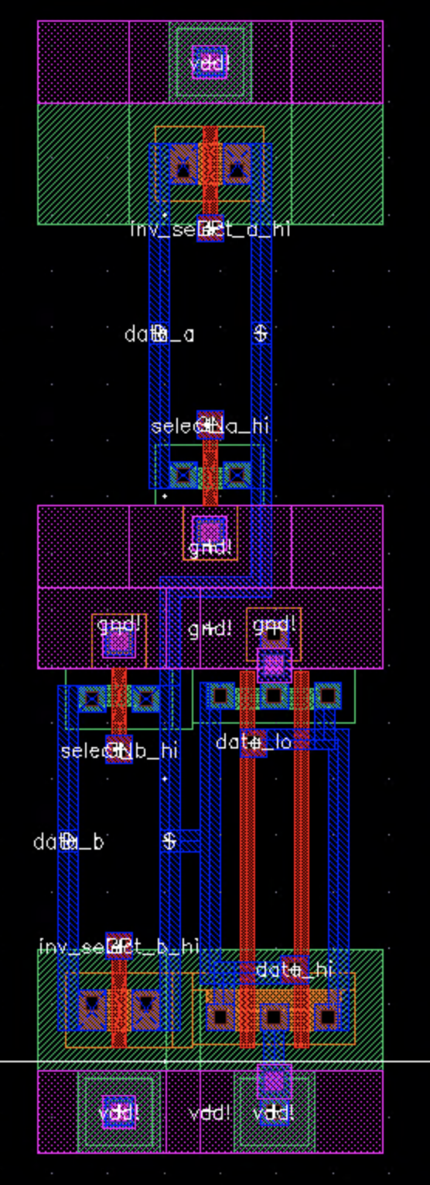
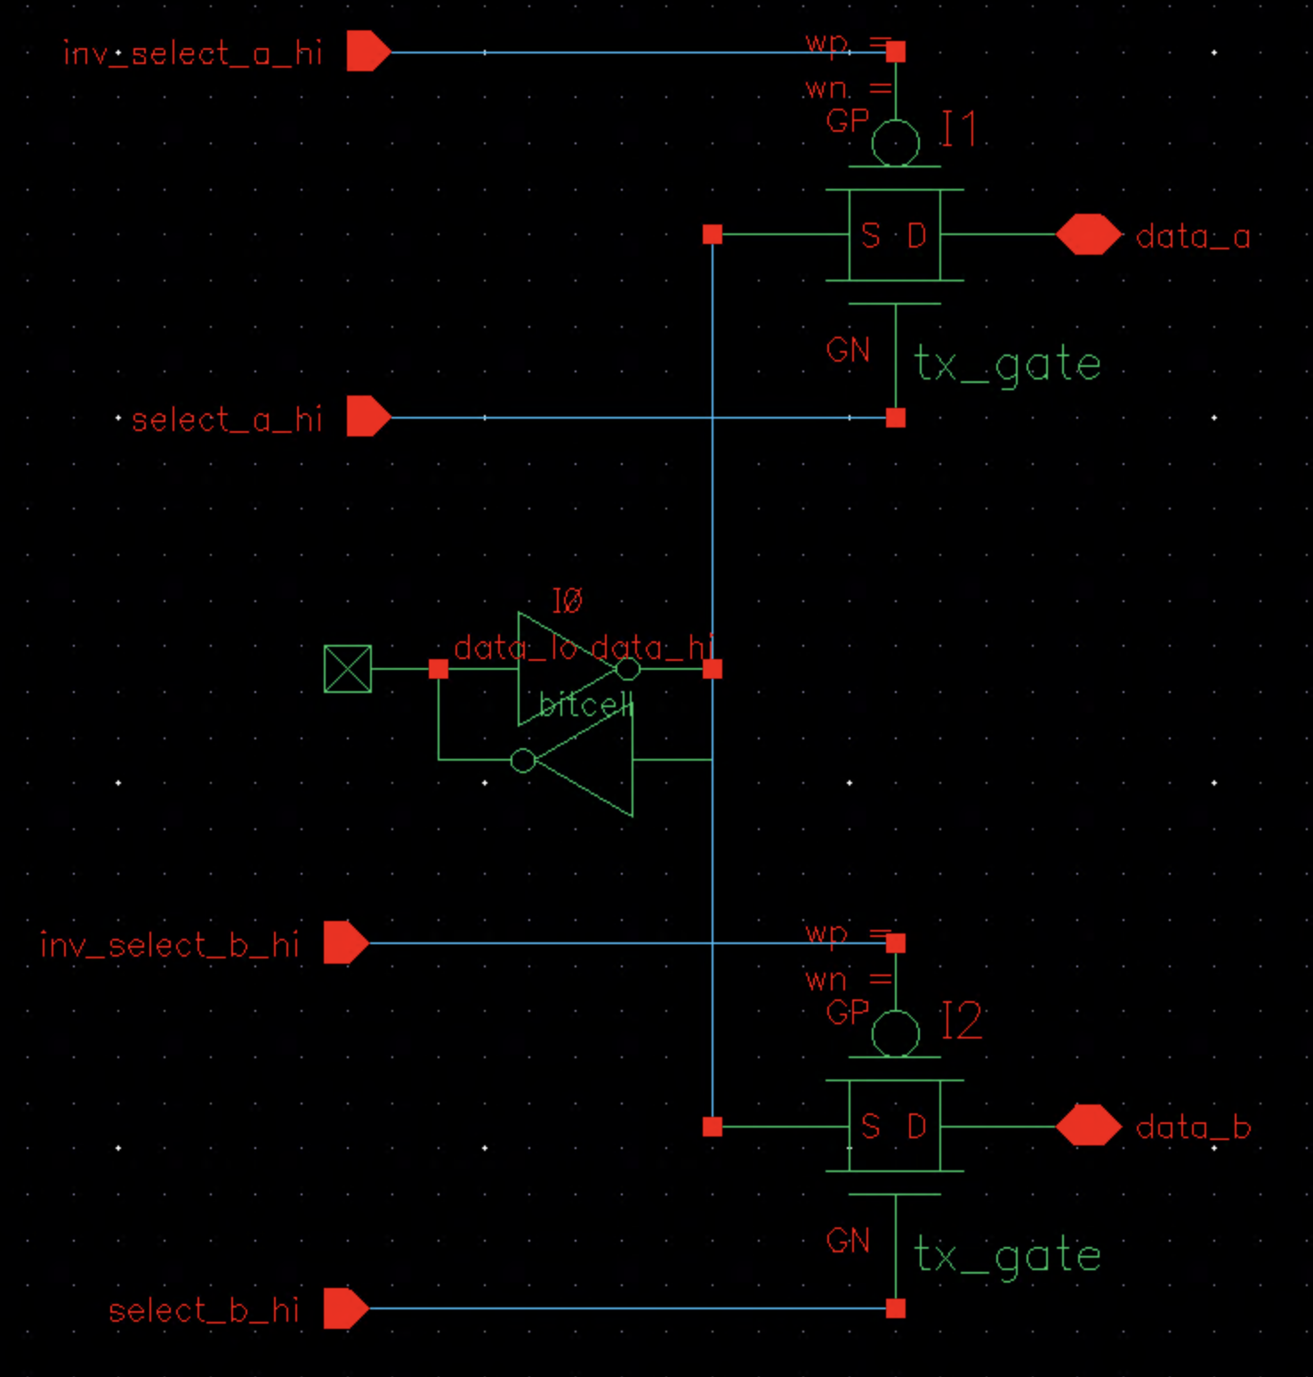
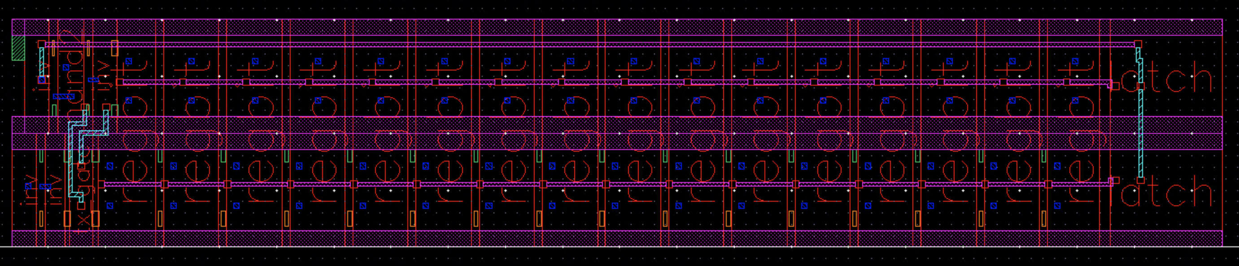
regbit and regfile Design
The design of the regbit cell took into consideration that the regfile cell will contain 32 identical copies of itself
Minimum transistors are utilized as the select signals applied to the transmission gates are supplied from the control unit, rather than using additional inverters to generate complementary signals
Two additional inverters would be necessary for each regbit to generate these signals, which accounts for 64 inverters!
This slight optimization recovered a huge portion of area in the overall design
regfile Layout
regbit Schematic
regbit Layout
regfile Layout (Level 0 Hierarchy)
ECE 425 MP2 PRESENTATION
GRAINGER ENGINEERING

Slide 11
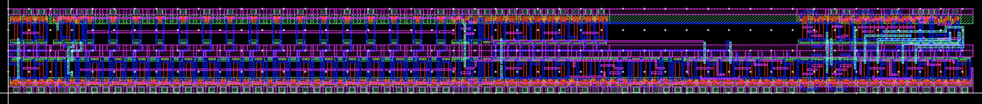
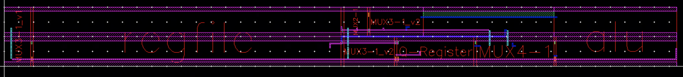
bitslice Design
bitslice Layout
bitslice Layout (Level 0 Hierarchy)
Up to this point in the design flow, floorplanning for bitslice was the most difficult
While the modular “rectangular” cell shape had worked nicely for connecting/routing previous cells, it was a challenge to maintain when laying out bitslice
Based on previous design choices and considerations, we ultimately were left with tradeoff decision between ease of routing and area consumption
Note the lack of metal3 used in bitslice in order to preserve using metal3 when connecting multiple bitslices
ECE 425 MP2 PRESENTATION
GRAINGER ENGINEERING

Slide 12
datapath Design
datapath Layout
metal3 primarily reserved for datapath vertical routing between bitslices
Modular design of previous cells allowed for this
ECE 425 MP2 PRESENTATION
GRAINGER ENGINEERING

Slide 13
Pitfalls and Future Considerations
datapath Layout
Large “gap” of unused area in each bitslice
This unused area “propagates” with each bitslice instance, adding to the overall area of the design
Result of poor floorplanning, cell placement, and signal routing
bitslice Layout
Very long metal2 track used in bitslice, spanning entire width of cell
Used to connect alu output, f, to necessary MUX inputs
In practice, this is not a good design choice as the long metal wire could introduce large amounts of delay due to interconnect resistance and capacitance, which could have a substantial impact of system functionality and performance.
ECE 425 MP2 PRESENTATION
GRAINGER ENGINEERING

Slide 14
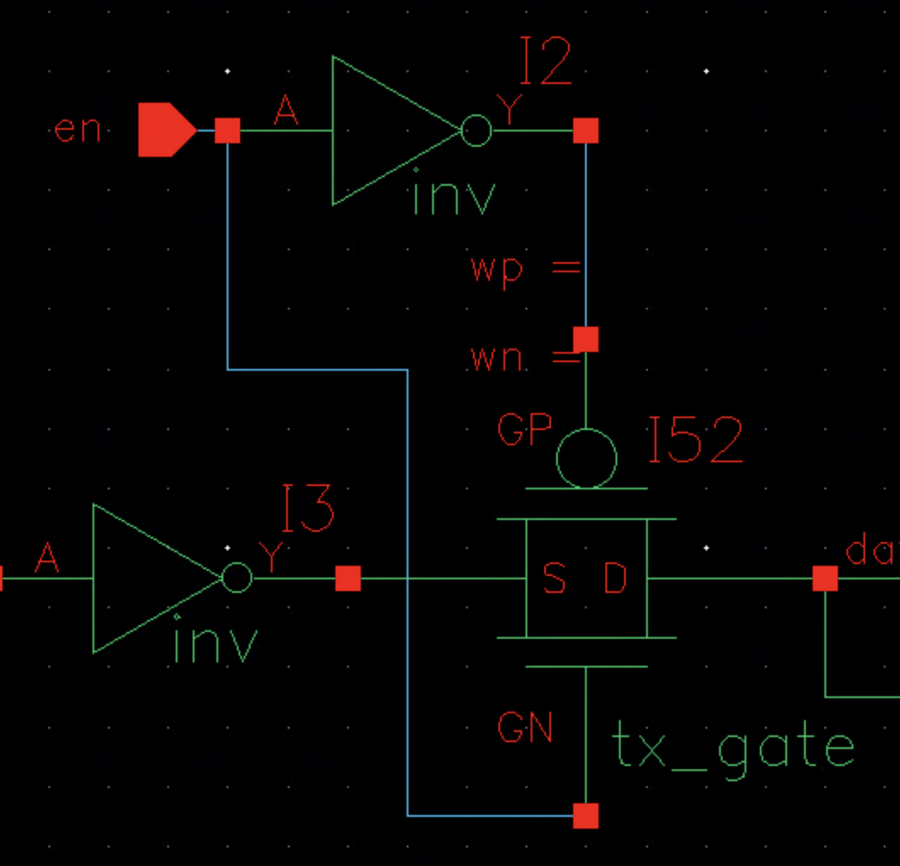
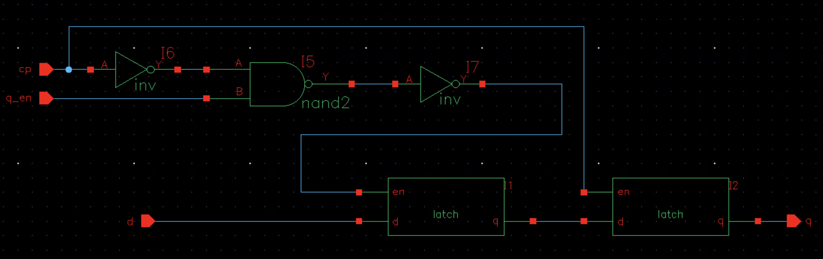
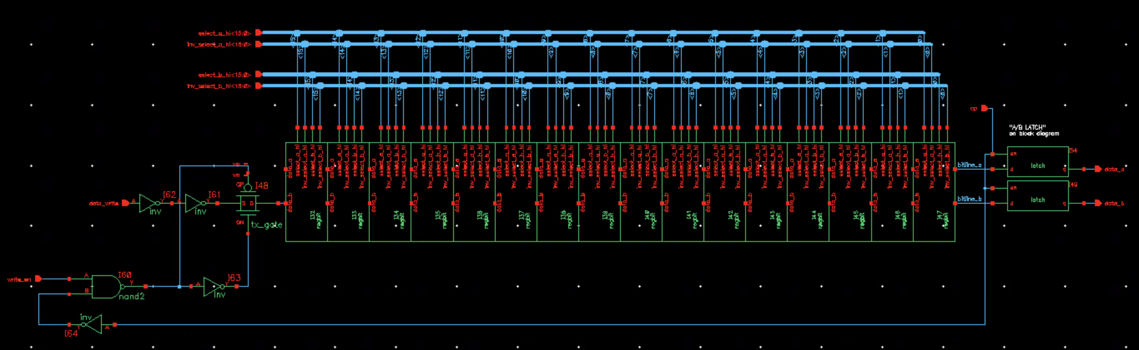
Pitfalls and Future Considerations cont.
Generating Inverted Signals: As previously mentioned, it is suggested to generate necessary inverted signals from the control unit, wherever possible!
Specifically in these cells below, the required inverted signals are generated using inverters
By generating the signals from the control unit rather than using inverters (or other logic gates), overall system design area is conserved, especially if a cell is reused multiple times throughout the design such as in regbit
Further, the omission of such gates could allow for more optimal floorplaning, cell placement, and signal routing
regfile Schematic
Q-Register Schematic
latch Schematic
ECE 425 MP2 PRESENTATION
GRAINGER ENGINEERING

Slide 15
Thank You For Listening!
Questions?
ECE 425 MP2 PRESENTATION
GRAINGER ENGINEERING

Slide 16


